Slide 1
Test Automation

Slide 2
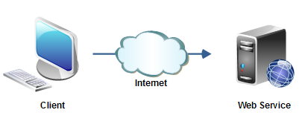
AS IS Scenario
Manual Test Cases for GUI and Web Services
Test Cases
GUI

Slide 3

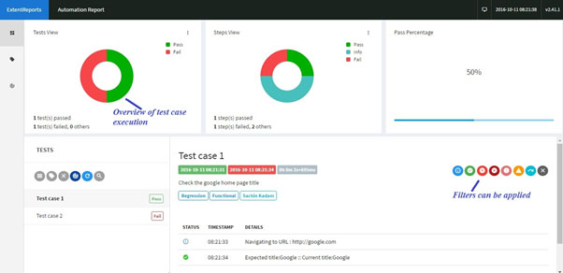



To Be Scenario
CUCUMBER FRAMEWORK
Automated Scripts
KARATE
SELENIUM WEB DRIVER
TEST Report
GUI
CONTINIOUS INTEGRATION & BUILD

Slide 4
Technical Details
Open Source tools to perform all automation testing
Selenium WebDriver ( Test Automation Tool)
Java ( Programming Language)
Cucumber ( Behavior Driven Development)
Maven ( Build Management Tool)
Jenkins (Continuous Integration)
SOAP UI / KARATE (Web services)
SELENIUM CUCUMBER
Framework
Gherkin Feature File
Step Definition
Runner File
Selenium
WebDriver
Script Execution
Firefox
IE
Chrome
JAVA
Cucumber Standard Report
Extent Report
JSON Report

Slide 5


